Slide 1
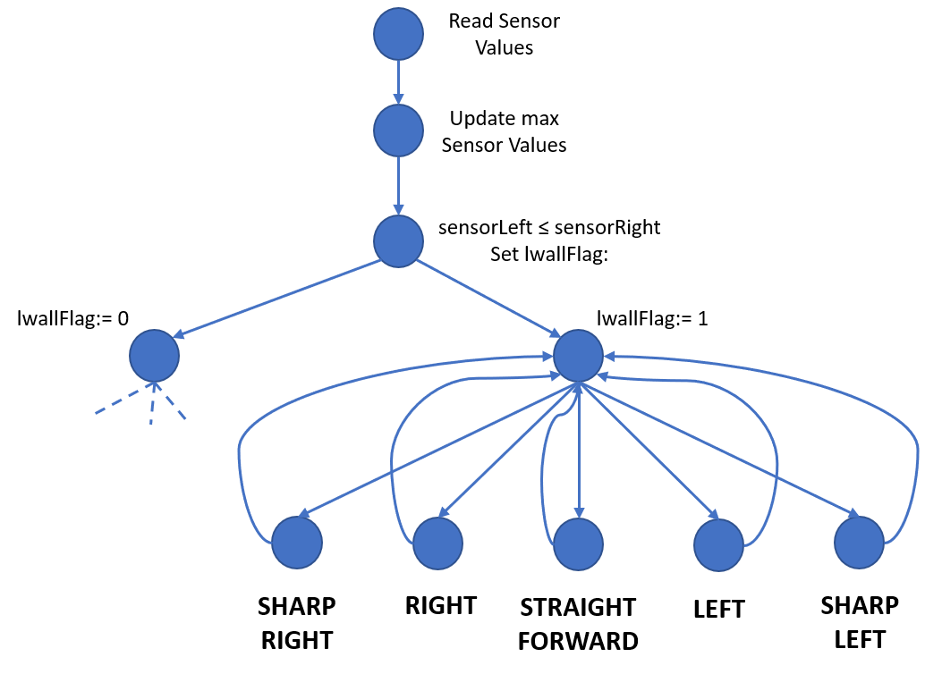
***
sleft: left sensor distance
sright: right sensor distance
sleftkeep: ideal distance from left wall
us: ultrasonic sensor
usmin: minimum value provided by ultrasonic sensor
srightmin: minimum distance from right wall
lwallflag: left wall flag (boolean)
SHARP RIGHT STATEMENT: IF ((sleftkeep -sleft) > tol12 && us>usmin && sright>srightmin) THEN myservo.write(i) for (i = 105:85:-5)
RIGHT STATEMENT: IF ((sleftkeep -sleft) > tol && us>usmin && sright>srightmin) THEN myservo.write(98)
STRAIGHT FORWARD STATEMENT: IF ((sleft -sleftkeep) ≤ tol && (sleftkeep -sleft) ≤ tol && us>usmin && sright>srightmin) THEN myservo.write(110)
LEFT STATEMENT: IF ((sleft -sleftkeep) > tol && us>usmin && sright>srightmin) THEN myservo.write(120)
SHARP LEFT STATEMENT: IF ((sleft -sleftkeep) > tol12 && us>usmin && sright>srightmin) THEN myservo.write(i) for (i = 115:135:5) ***

